Slide 1

Liver Cirrhosis Prediction with XGboost & EDA
Initial Review

Slide 2

Abstract
This research addresses the growing concern of liver cirrhosis in North America, predominantly linked to alcohol consumption. Leveraging advanced machine learning techniques, we aim to develop a comprehensive predictive model by integrating lifestyle factors (such as alcohol consumption, dietary habits, and exercise) and health indicators (including viral hepatitis status and liver function tests).
Index Terms: Liver Cirrhosis, Predictive Modelling, Risk Assessment, Alcohol Consumption, Lifestyle Factors, Health Indicators

Slide 3
Literature Survey
Traditional medical studies on liver cirrhosis rely on information obtained through personal contact with healthcare professionals.
Recent research has demonstrated the potential of utilizing social media data for studying mental health conditions , but there's limited exploration in the context of liver cirrhosis.
We focus on liver cirrhosis, a serious condition affecting millions globally, with particular prevalence among certain groups such as chronic alcohol users. We introduce a novel method for building a cirrhosis classifier, offering cost-effective training data compared to conventional approaches.

Slide 4
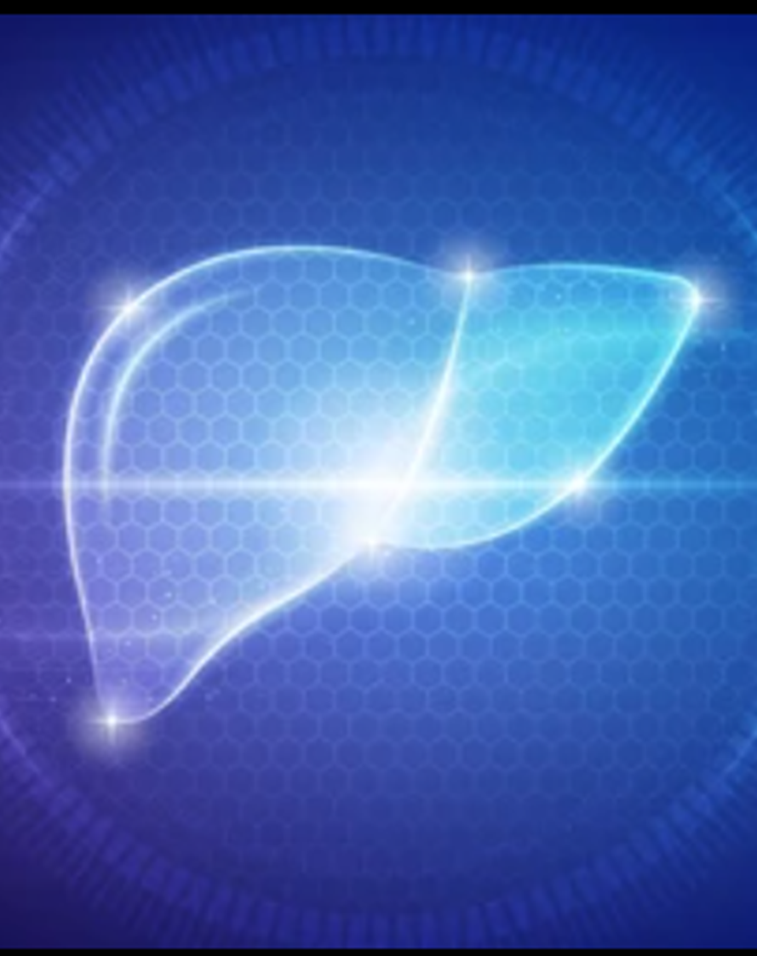
Problem Statement
Liver cirrhosis is a big problem globally, especially in North America, where more people are getting it, mostly because of drinking alcohol. Even though doctors know more about it now, we still need better ways to find it early and figure out who's at risk. This problem statement is about making a smart tool that can predict if someone might get cirrhosis by looking at their lifestyle and health, so doctors can help them before it gets worse.

Slide 5
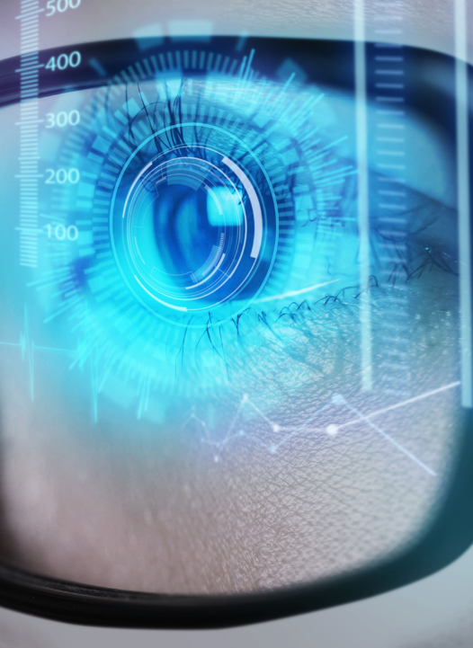
Existing Solution
Traditional methods for the prediction of liver cirrhosis are the gradient boosting methods
But unfortunately these machine learning models are not so much efficient when compared to other machine learning algorithms
Which can be subjected to time- consuming and may depend on other physiological measures which can be invasive and require specialized equipment. These methods also require significant expertise to interpret the data accurately.

Slide 6

Disadvantages
Accuracy
TIME
The accuracy is one of the major entity which can effect the entire outcome of the project
Due to the usage of old machine learning algorithm, the time consumption is higher than the new algorithm

Slide 7

Proposed solution
Usage of latest algorithms line XGboost (Extreme Gradient Boosting Algorithm) and EDA ( Exploratory Data Analysis ) may help to increase the accuracy and reduce the time consumption

Slide 8

System requirements
Hardware requirements​
Operating System :Windows, Linux
Processor :Minimum intel i3
RAM : Minimum 4GB
Software requirements
Jupyter Notebook, Google Colab, Modules like Numpy, Pandas, Matplotlib, Seaborn

Slide 9




modules
NumPy
pandas
matplotlib
seaborn
Numerical computing that provides support for large, multi-dimensional arrays and matrices
High-performance, easy-to-use data structures and data analysis tools, particularly designed for working with structured data.
Creating static, interactive, and animated visualizations in various formats, including line plots, scatter plots, bar charts, histograms, and more.
Statistical data visualization library in Python that simplifies the creation of complex and visually appealing plots.

Slide 10
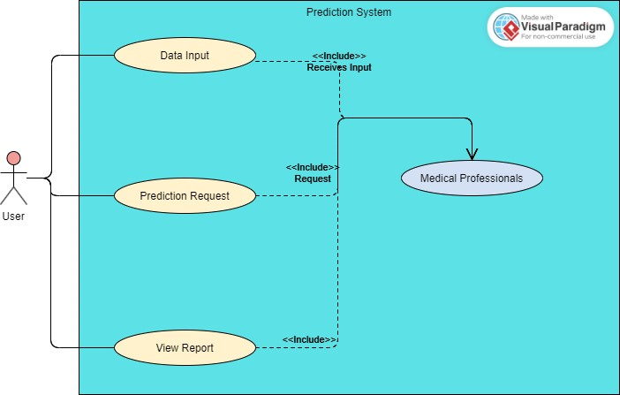
Use case diagram

Slide 11

Thank you

